Slide 1
Chapter 1
What is engineering drawing?
Engineering drawing is a formal and exact way of communicating information about the shape, size and precision of physical objects.
Engineering drawing can be undertaken by the use of free hand, mechanical methods (using instrument) and computer methods (computer graphics).
The use of engineering drawings is that how a picture is better than a thousand words. While just using text to relate information and ideas can be boring, engineering drawings can easily transfer information to make it more understandable.

Slide 2
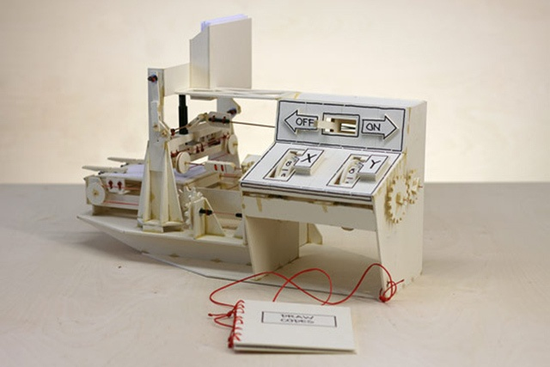
Engineering Drawing

Slide 3
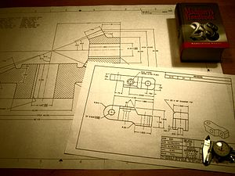
engineering drawing
Engineering Drawing

Slide 4
Importance of Engineering Drawing
Engineering drawing allows efficient communication among engineers and can be kept as a record of the planning process.
Engineering drawing is a much more effective tool for engineers than a written plan.
Engineering drawing is a way of transferring information to make things more understandable.
Notes:
How

Slide 5
Fields of Use
Engineering drawing is the preferred method of drafting in all engineering fields, including, but not limited to, civil engineering, electrical engineering, mechanical engineering and architecture.
Drawing Standard Paper layout
Many paper size standards conventions have existed at different times and in different countries. Today
1)International Organization for Standardization ISO (Including A4, B3, C4, etc.) and
2)North America or ANSI/ASME Y14

Slide 6
ISO A Drawing Sizes (mm) |  | ANSI/ASME Drawing Sizes (inches)
A4 | 210 X 297 | A | 8.5" X 11"
A3 | 297 X 420 | B | 11" X 17"
A2 | 420 X 594 | C | 17" X 22"
A1 | 594 X 841 | D | 22" X 34"
A0 | 841 X 1189 | E | 34" X 44"

Slide 7
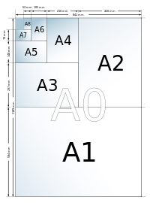

Slide 8

Engineering drawing tools
Engineering drawing tools are the tools used for engineering drawing, including pens and rulers. Drawing tools may be used for measurement and layout of drawings, or to improve the consistency and speed of creation of standard drawing elements.
Pens or pencils
Traditional and typical pens used for engineering drawing are pencils and engineering pens. Pencils in use are usually mechanical pencils with a standard lead thickness. General line widths are 0.18 mm, 0.25 mm, 0.5 mm and 0.7 mm. Hardness varies usually from HB to 2H.
Traditional already in the 1600s used ruling pen.

Slide 9
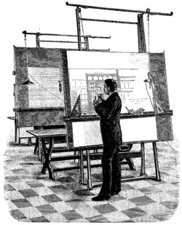
Drawing board
The drawing board is an essential tool. Paper will be attached and kept straight and still, so that the drawing can be done with accuracy. Generally, different kinds of assistance rulers are used in drawing. The drawing board is usually mounted to a floor pedestal in which the board turns to a different position, and also its height can be adjustable.

Slide 10
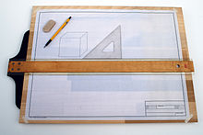
T-square
A T-square is a straightedge which uses the edge of the drawing board as a support. It is used with the drafting board to draw horizontal lines and to align other drawing instruments. Wood, metal, or plastic triangles with 30 and 60 degree angles or with two 45 degree angles are used to speed drawing of lines at these commonly used angles.

Slide 11
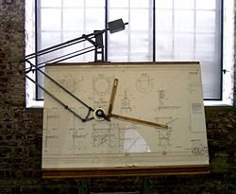
Drafting machine
A drafting machine is a device which is mounted to the drawing board. It has rulers whose angles can be precisely adjusted with a controlling mechanism.
A drafting machine allows easy drawing of parallel lines over the paper.

Slide 12
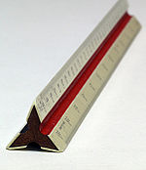
Rulers
Rulers used in engineering drawing are usually made of polystyrene. Rulers are also used to easy drawing of straight lines over the paper.

Slide 13
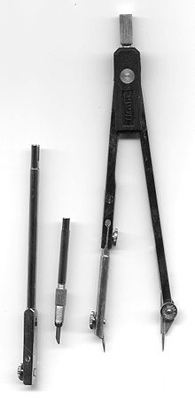
Compass
The compass is used for drawing circles or arc segments of circles. One form has two straight legs joined by a hinge; one leg has a sharp pivot point and the other has a holder for a engineering pen or pencil.
Another form, the beam compass, has the pivot point and pen holder joined by a bar, useful when drawing very large radius arcs.

Slide 14
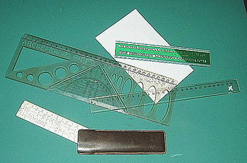
Templates
Templates contain pre-dimensioned holes in the right scale to accurately draw a symbol or sign. Letter templates will deliver the text, as well number as letter characters.

Slide 15
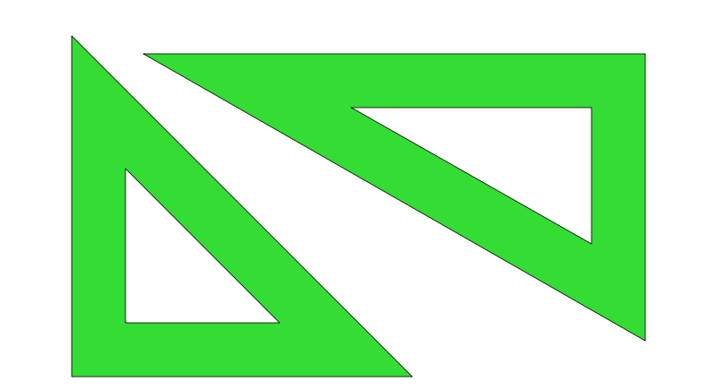
Set square
A set square is an object used in engineering or technical drawing, with the aim of providing a straightedge at a right or other particular planar angle to a baseline.
Set squares come in two usual forms, both right triangles: one with 90-45-45 degree angles, the other with 30-60-90 degree angles.

Slide 16

French curve
French curve is a template made out of metal , wood or plastic composed of many different curves. It is used in manual drafting to draw smooth curves of varying radii.

Slide 17


Types of lines and their applications
1.Visible Outlines, Visible Edges : (Continuous wide lines) The lines drawn to represent the visible outlines/ visible edges / surface boundary lines of objects should be outstanding in appearance.
2.Dimension Lines: (Continuous narrow Lines)
are drawn to mark dimension.
3.Extension Lines:(Continuous narrow Lines)
There are extended slightly beyond the respective dimension lines.
4.Construction Lines: (Continuous narrow Lines)
are drawn for constructing drawings and should not be erased after completion of the drawing.

Slide 18

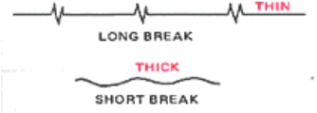
.
5.Hatching / Section Lines: (Continuous Narrow Lines) are drawn for the sectioned portion of an object. These are drawn inclined at an angle of 45° to the axis or to the main outline of the section.
6.Guide Lines: (Continuous Narrow Lines) are drawn for lettering and should not be erased after lettering.
7. Break Lines:(Continuous Narrow Freehand Lines) Wavy continuous narrow line drawn freehand is used to represent break of an object.

Slide 19
.
8.Hidden Lines: (Dashed Narrow Lines)
Hidden edges / Hidden outlines of objects are shown by dashed lines of short dashes of equal lengths of about 3 mm, spaced at equal distances of about 1 mm. the points of intersection of these lines with the outlines / another hidden line should be clearly shown.
9.Center Lines: (Long-Dashed Dotted Narrow Lines) are drawn at the center of the drawings symmetrical about an axis or both the axes. These are extended by a short distance beyond the outline of the drawing.

Slide 20
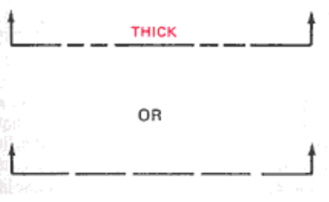
.
10.Cutting Plane Lines: is drawn to show the location of a cutting plane. It is long-dashed dotted narrow line, made wide at the ends, bends and change of direction. The direction of viewing is shown by means of arrows resting on the cutting plane line.
11.Border Lines : are continuous wide lines of minimum thickness 0.7mm.

Slide 21
Precedence of Lines
1. When a Visible Line coincide with a Hidden Line or Center Line, draw the Visible Line. Also, extend the Center Line beyond the outlines of the view.
2. When a Hidden Line coincides with a Center Line, draw the Hidden Line.
3. When a Visible Line coincides with a Cutting Plane, draw the Visible Line.
4. When a Center line coincides with a Cutting Plane, draw the Center Line and show the Cutting Plane line outside the outlines of the view at the ends of the Center Line by thick dashes.

Slide 22
Technical Lettering
Lettering is an impotent part of engineering drawing. It gives information regarding size, and instructions, in the form of notes and dimension.
It is not hand written.
Lettering is appropriate and correct words but not printing (Printing means production of printed material on a printing press).
Writing of alphabets and numerals such as A, B, C, D … Z and 0 ,1, 2, 3…………9 respectively is called Lettering.
Mainly, there are two types of lettering most commonly used in engineering drawing Gothic Lettering and Roman Lettering.

Slide 23
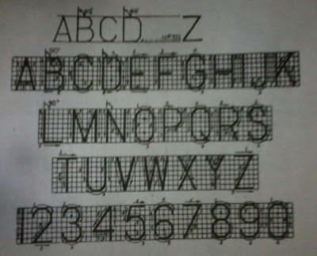
Gothic Lettering
Lettering having all the alphabets or numerals of uniform thickness is called Gothic Lettering.
Vertical Gothic Lettering
Italic or Inclined Gothic Lettering.
Single Stroke Vertical Gothic Lettering
These are vertical letter having thickness of each line of alphabet or numerals etc. Same as the single stroke of a pencil.

Slide 24
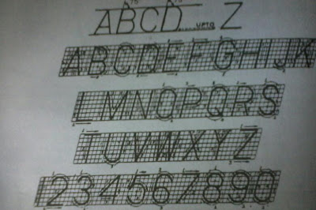
Single Stroke Inclined Gothic Lettering
These are single stroke letter inclined at 75' to the Horizontal.

Slide 25
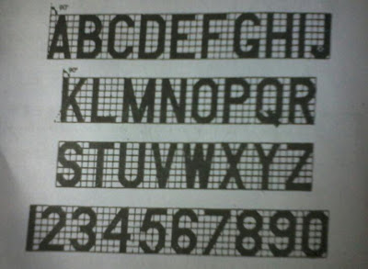
Double Stroke Vertical Gothic Lettering
Vertical letter drawn by double Stroke of pencil with uniform thickness between these strokes are called Double Stroke Vertical Gothic Lettering.

Slide 26
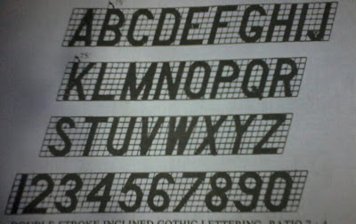
Double Stroke Inclined Gothic Lettering
Double stroke gothic when inclined at an angle of 75' is called Double Stroke Inclined Gothic Lettering.

Slide 27
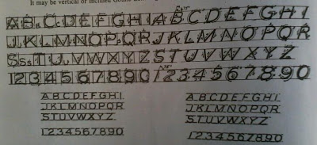
Free Hand Lettering
The writing of alphabets without the use of drawing instruments and in free hand is called Free Hand Lettering.
It may be vertical or Inclined Gothic Lettering.

Slide 28
ABCDEFGHIJKLMNOPQRSTUVWXYZ
0123456789

Slide 29

Please read very hard!!!
The entire course you take.

